Slide 1

IoT Architecture
Turning Ideas into Intelligent Devices

Slide 2
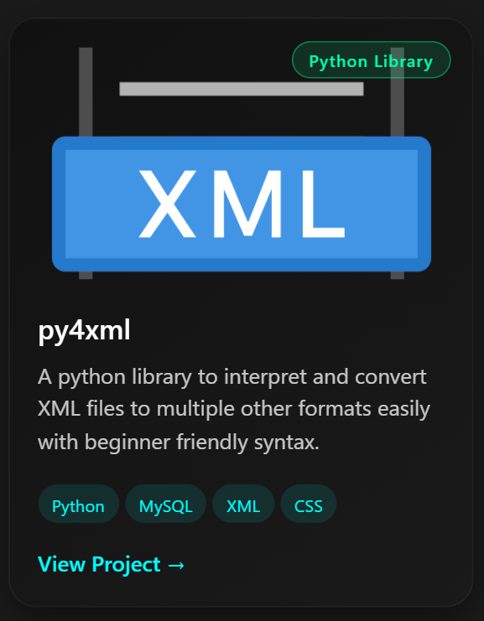
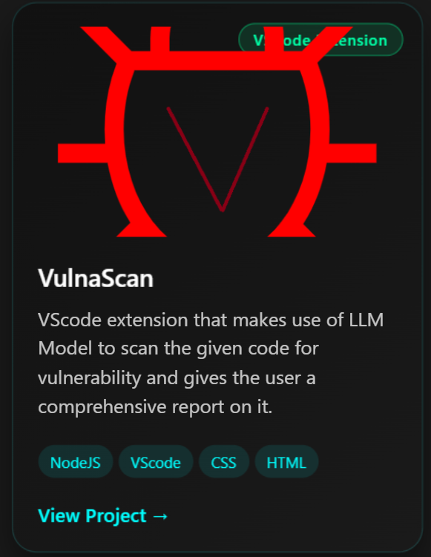
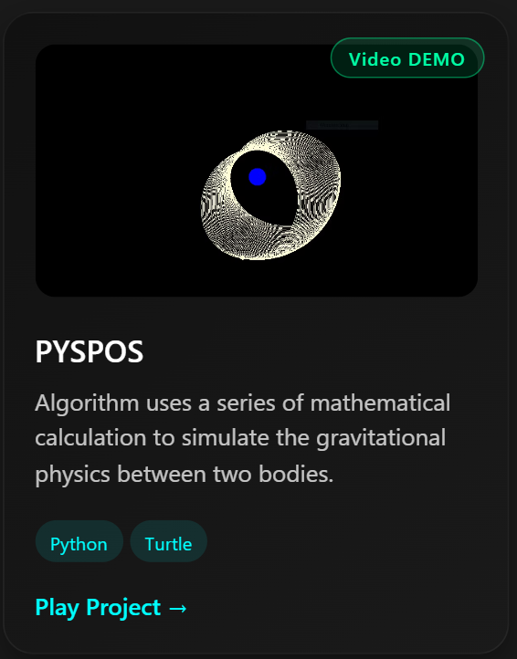
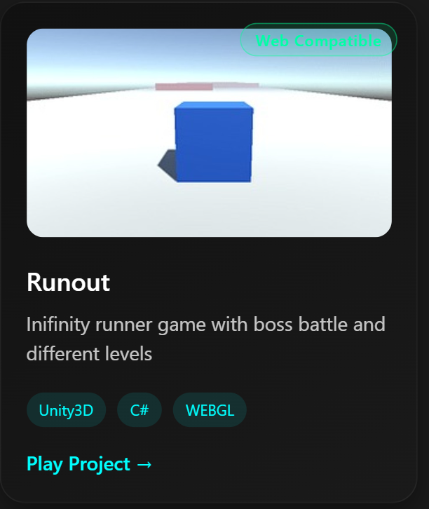
A bit about me
Ankit Aggarwal (Mentor of R&D Domain at ACE)
Building intelligent systems, interactive simulations, and AI-driven applications.
My Portfolio : https://masterank15.wixsite.com/ank4code/about
Instagram Link: https://www.instagram.com/masterank15

Slide 3
Agenda
-> Basic Introduction
-> IoT Chips
-> IoT simulation programs:
-> Blink LED
-> Pushbutton Code
-> Speedometer
-> PCB Design

Slide 4
Basic Introduction
The Internet of Things (IoT) refers to a network of physical objects—"things"—embedded with sensors, software, and technologies that connect and exchange data with other devices and systems over the internet without human intervention. It enables real-time monitoring, automation, and efficiency across industries like manufacturing, healthcare, and smart homes

Slide 5
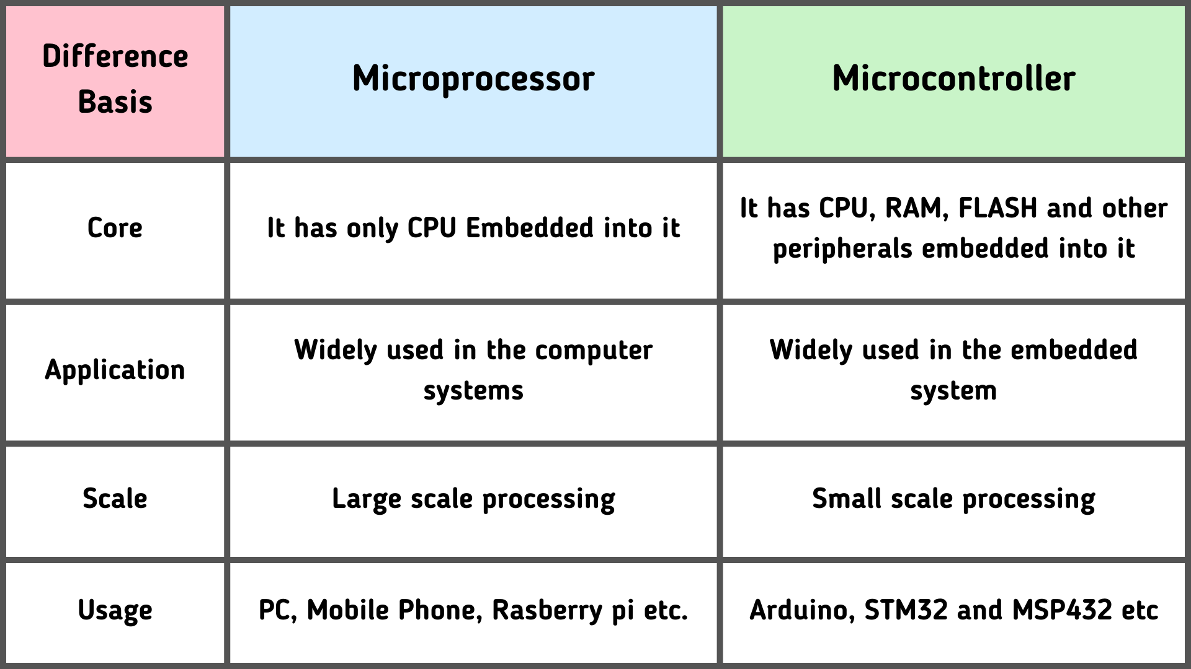
IOT CHIPS

Slide 6
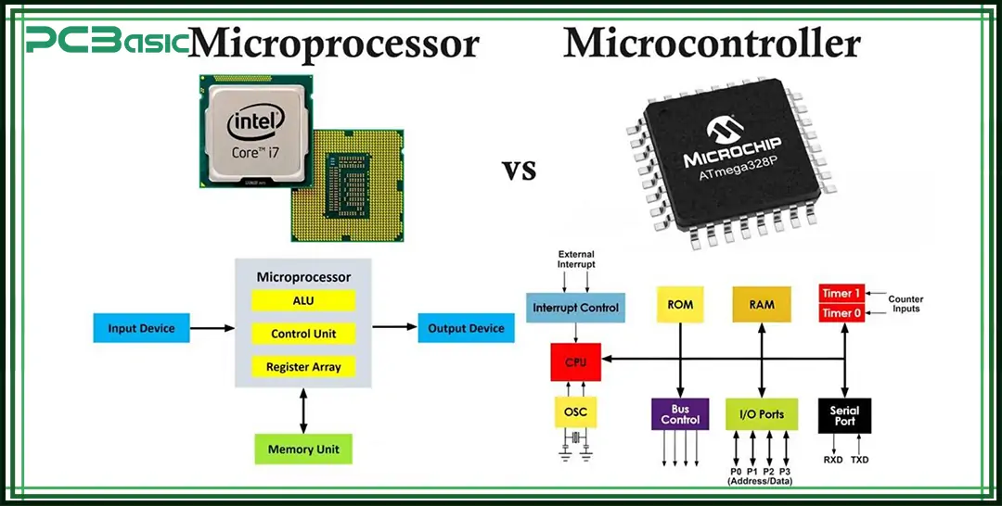
IOT CHIPS

Slide 7
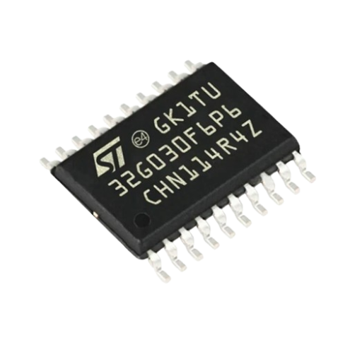
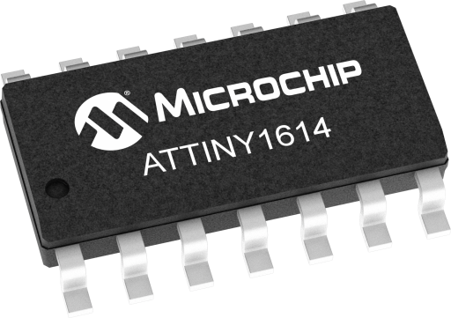
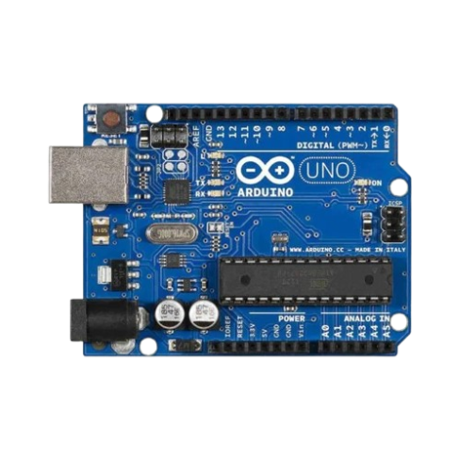
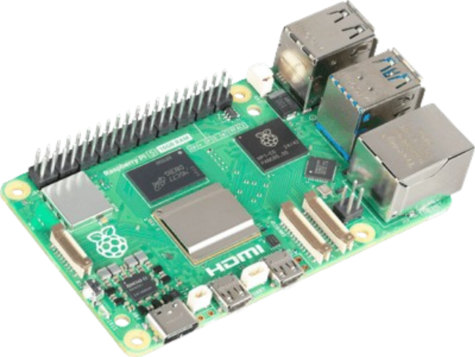
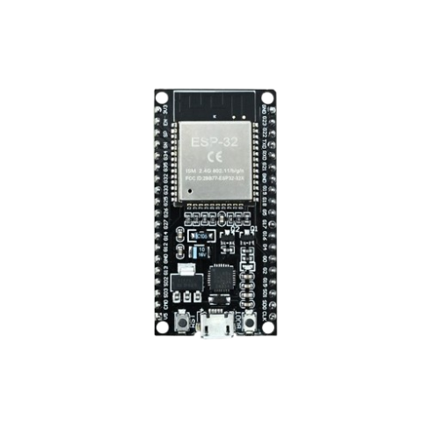
IOT CHIPS

Slide 8
IOT CHIPS

Slide 9
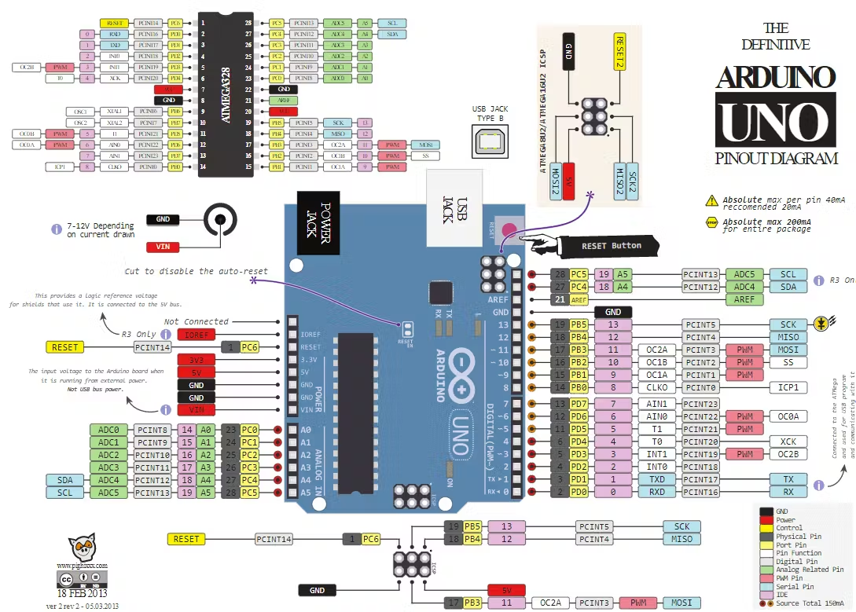
IOT CHIPS

Slide 10
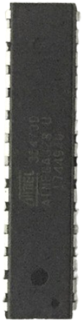
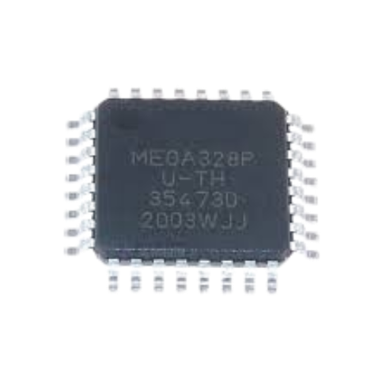
IOT CHIPS
The ATmega328P chip is available in multiple package sizes, with the most common being the 32-pin TQFP (7.1 X 7.1 X 1.05 mm ) used in SMD, and the 28-pin DIP ( 34.7 X 7.5 X 3.5 mm approximate) used for breadboarding. It features 32KB Flash, 2KB SRAM, and operates at up to 20 MHz

Slide 11
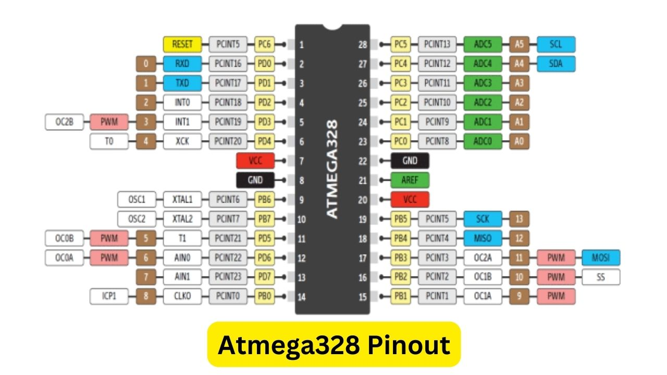
IOT CHIPS

Slide 12
IOT CHIPS

Slide 13
IOT CHIP SIZE
Arduino UNO atmega328p TQFP chip in its actual size of 7.1 X 7.1 mm

Slide 14
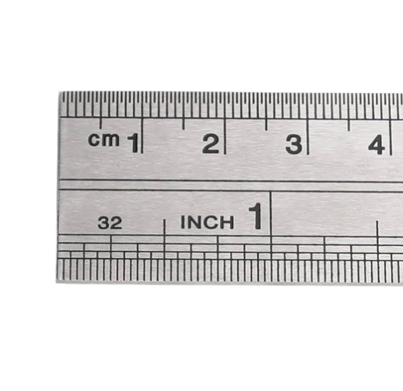
IOT CHIP SIZE

Slide 15
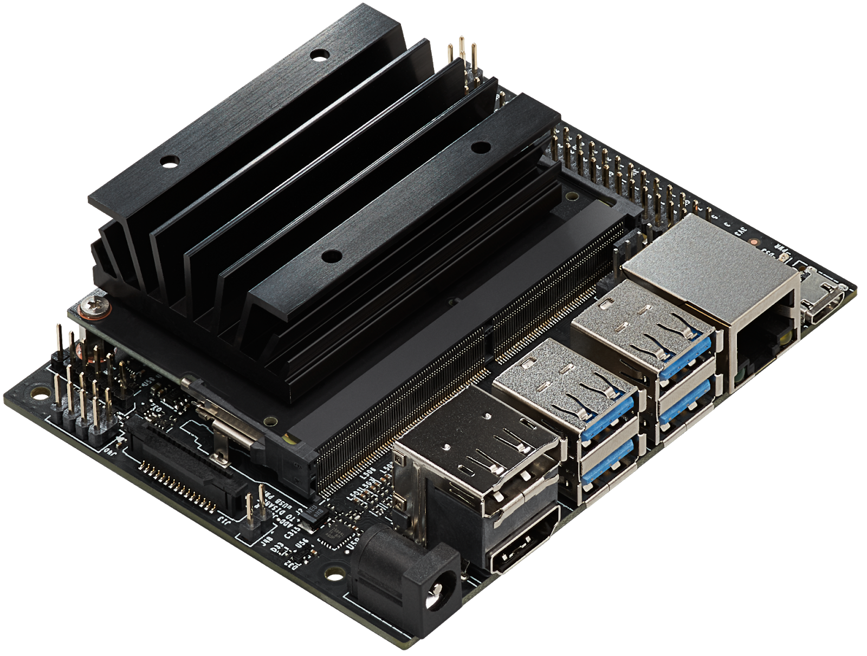
IOT CHIPS
Microprocessor used by OpenAI to train ChatGPT

Slide 16
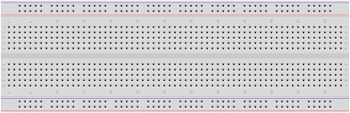
BreadBoard

Slide 17
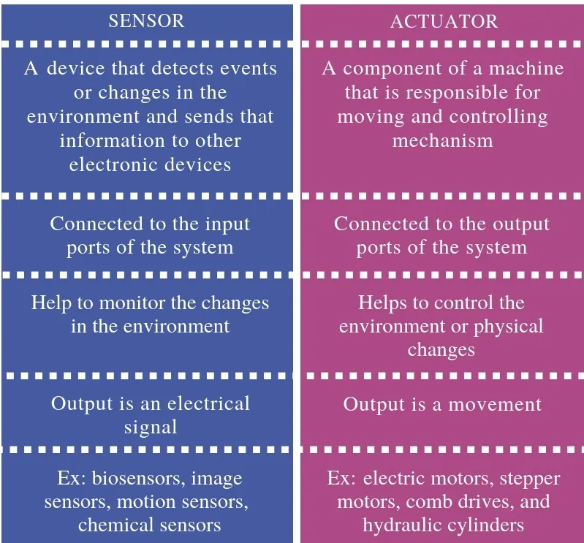
IOT Components

Slide 18
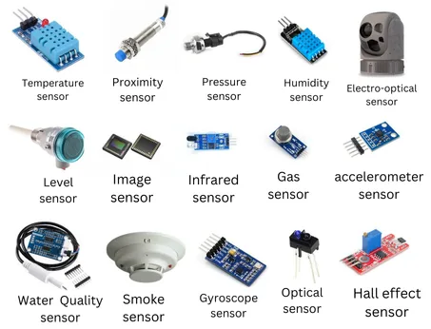
IOT Components

Slide 19

Thank for Attending

